Slide 1
Meshtastic
An overview and critique
KI7NNP

Slide 2

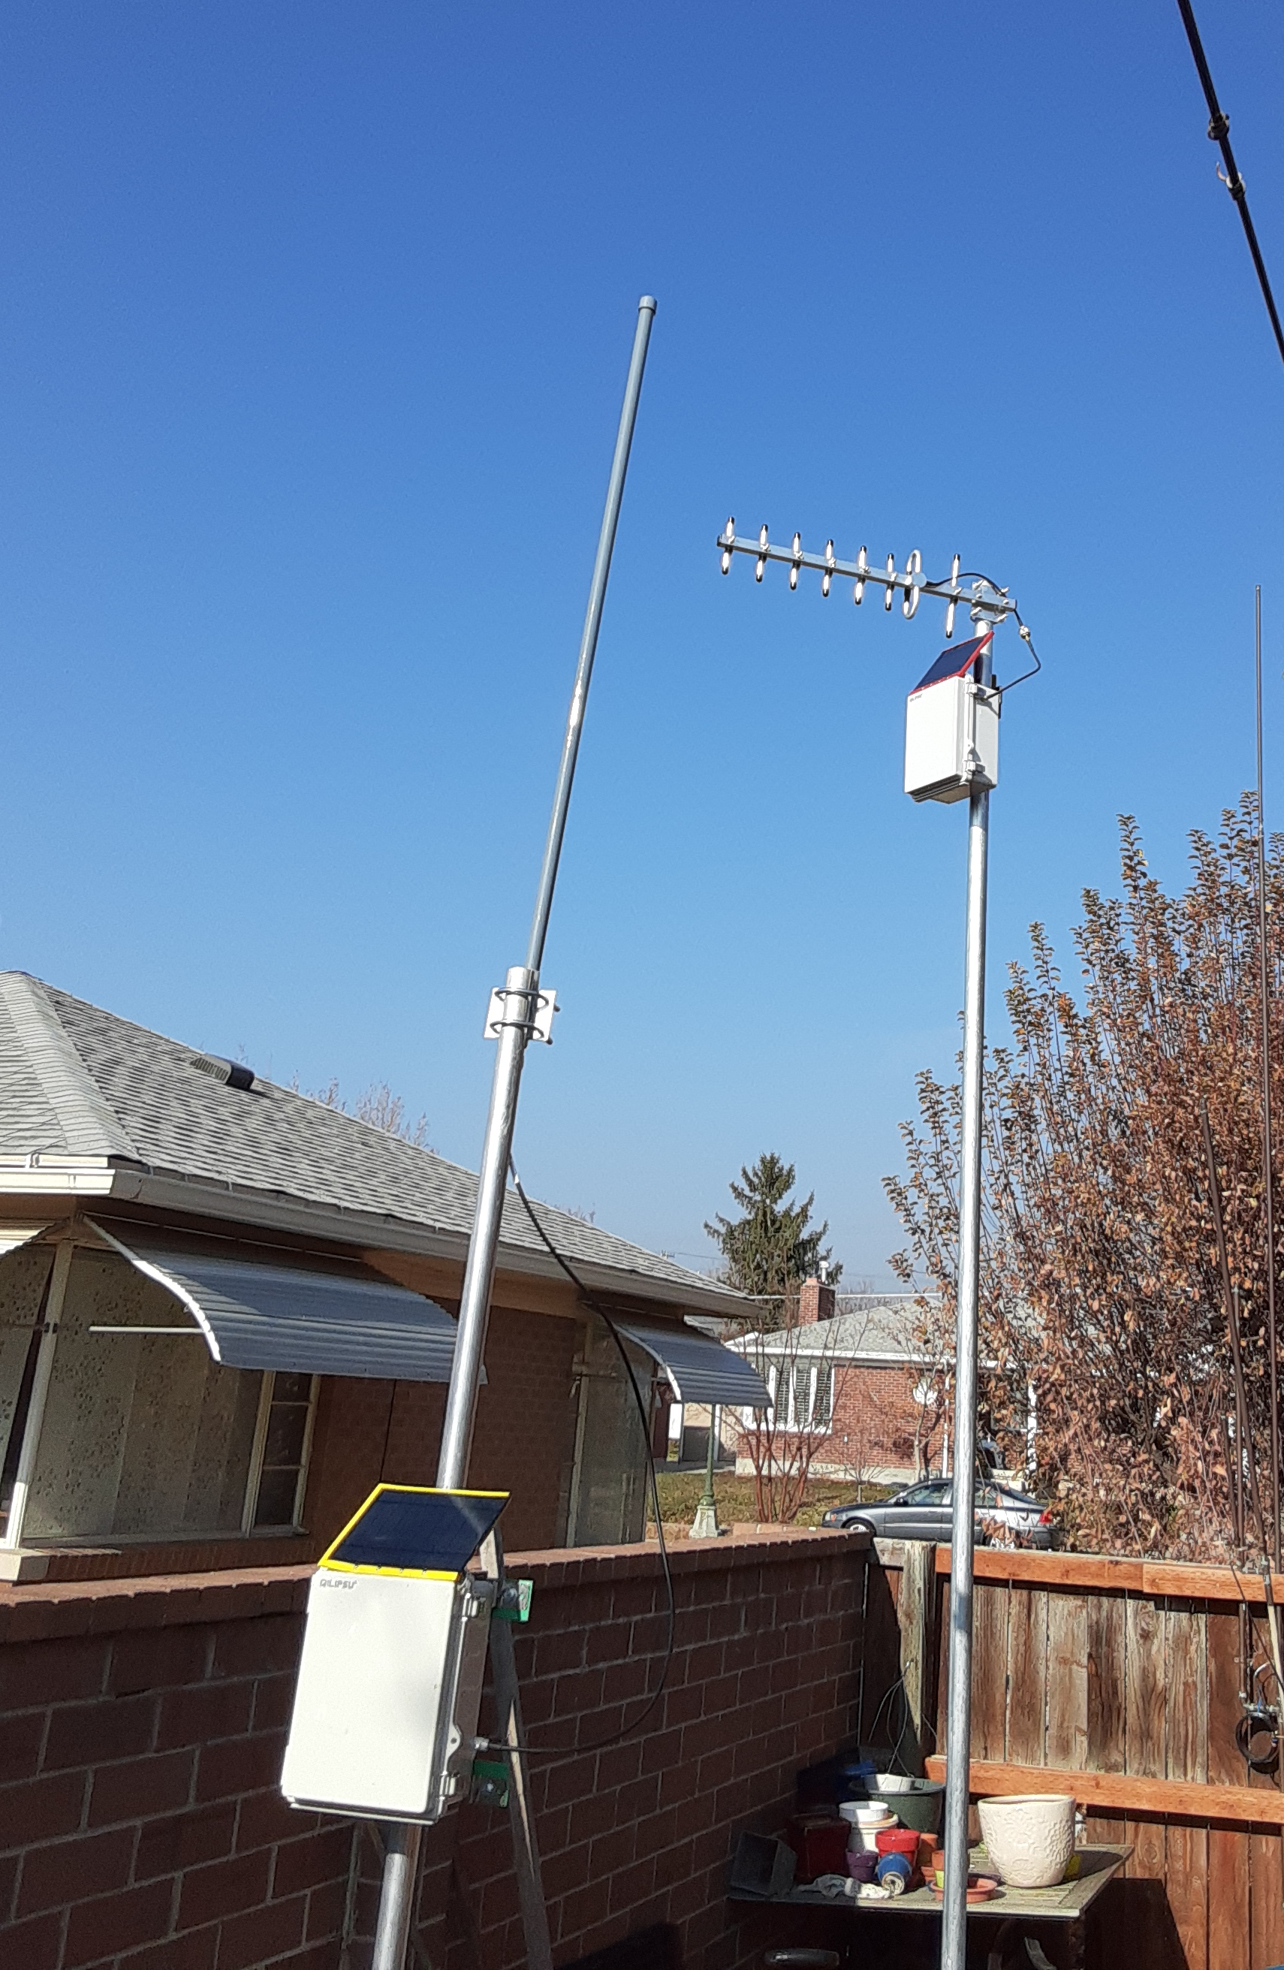
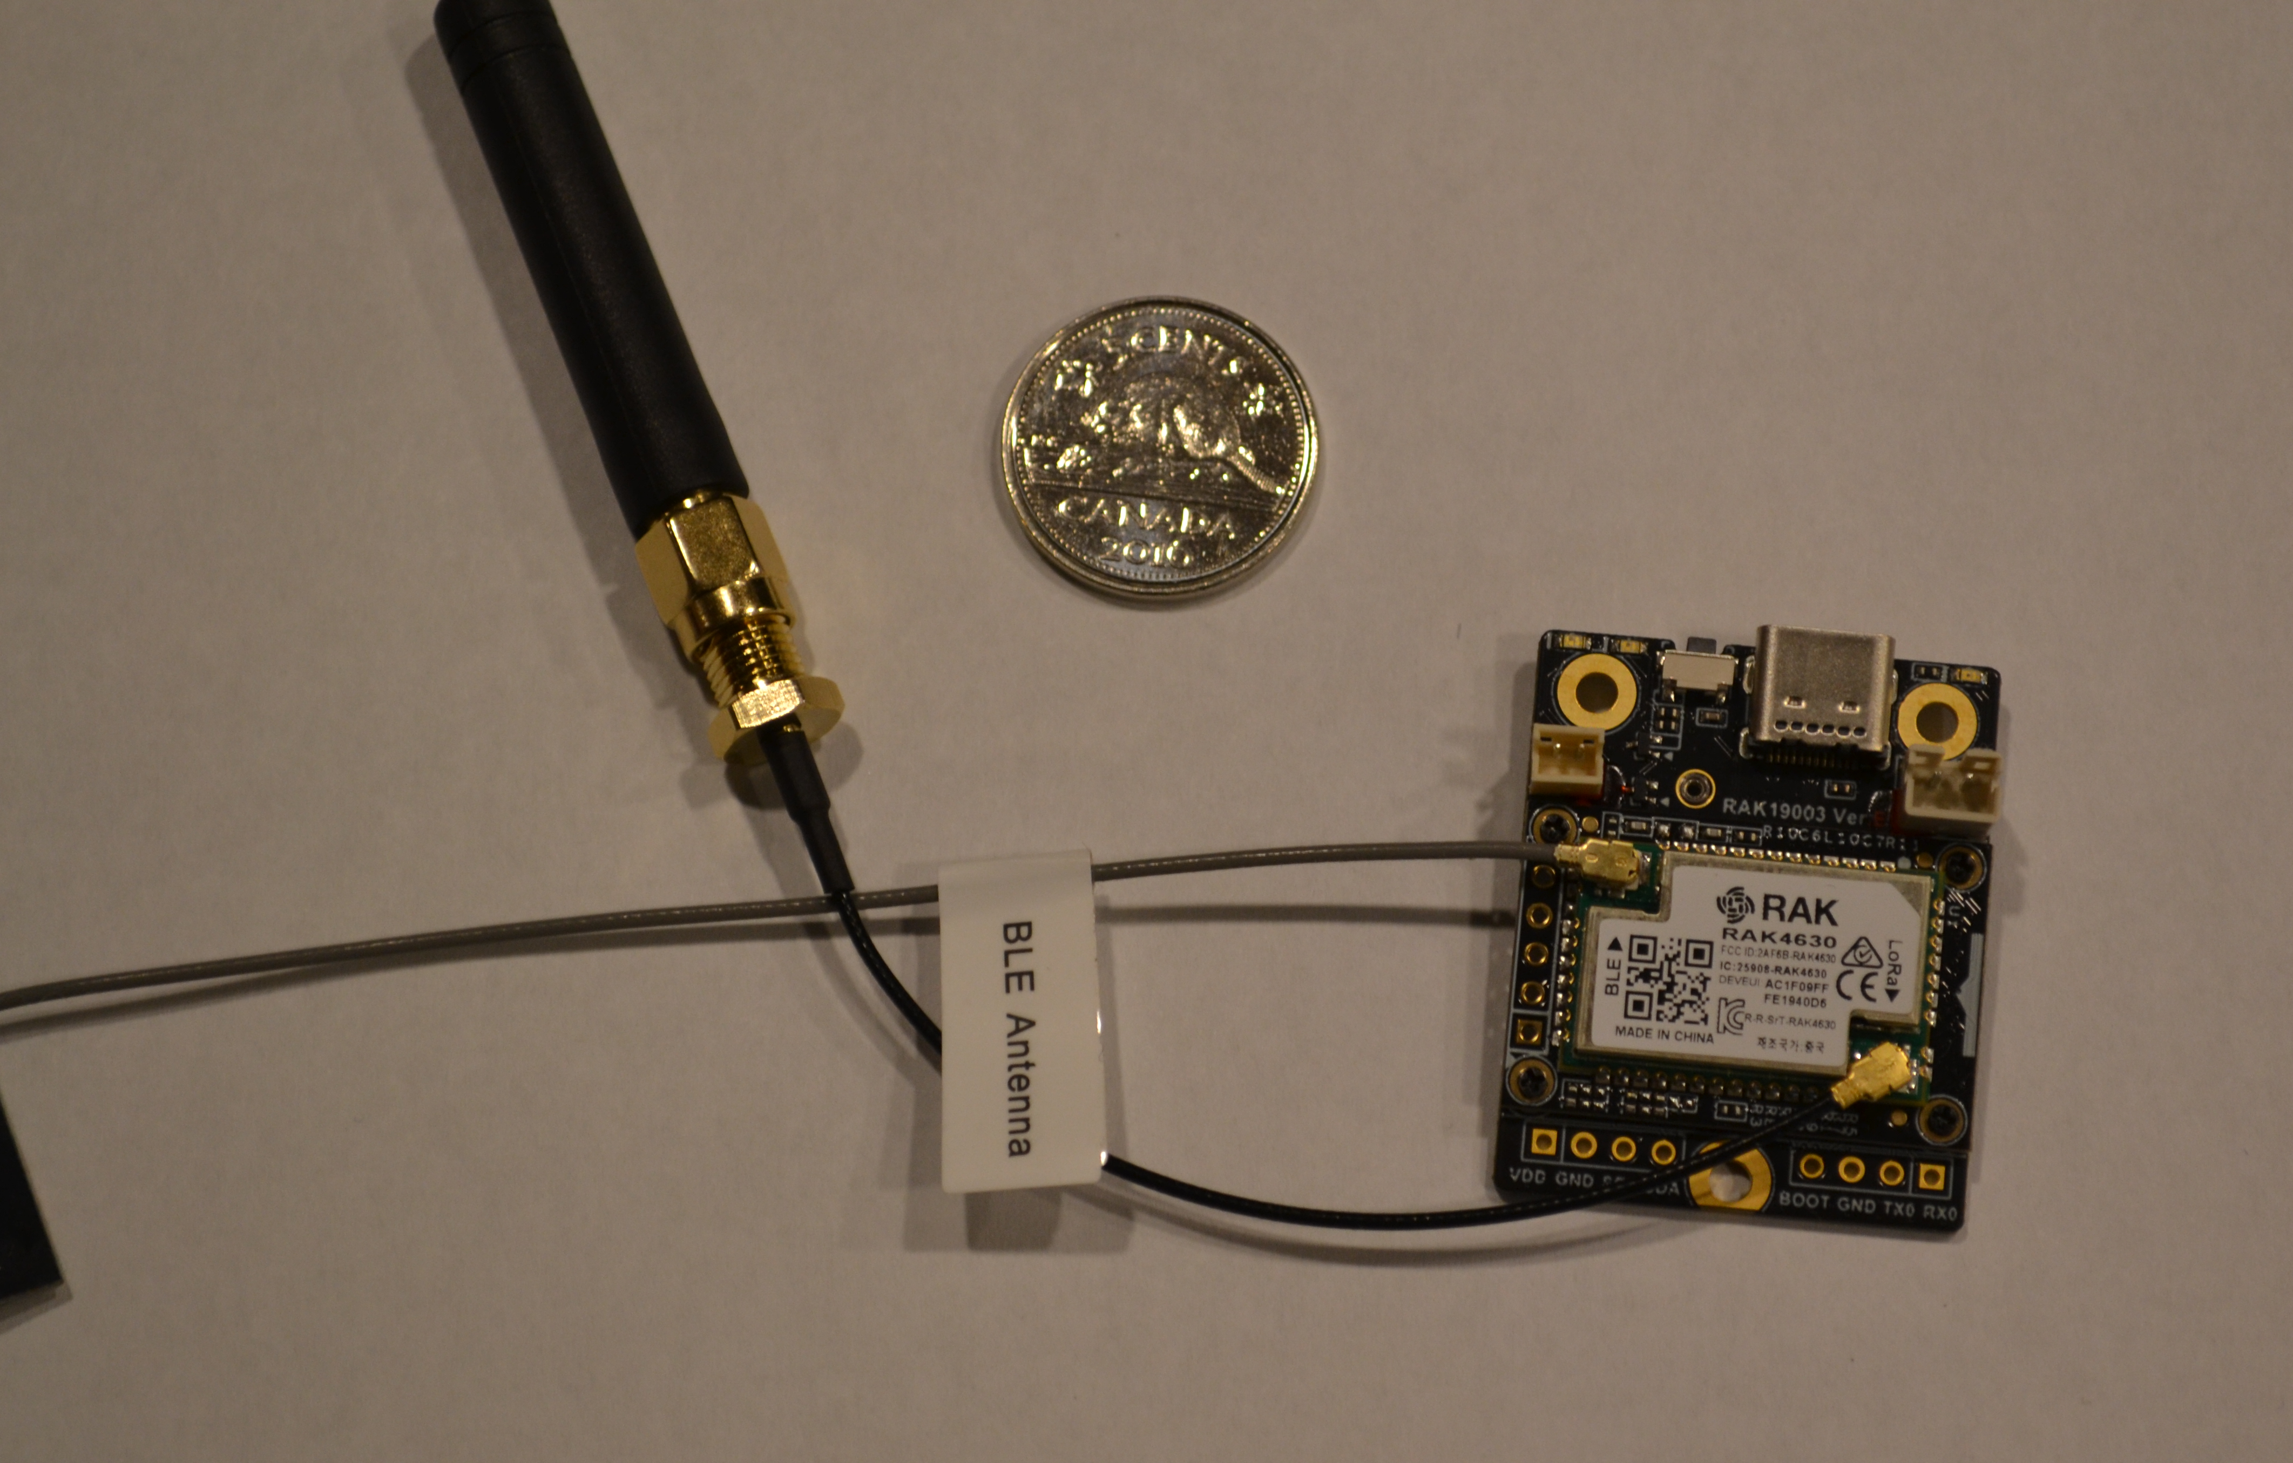
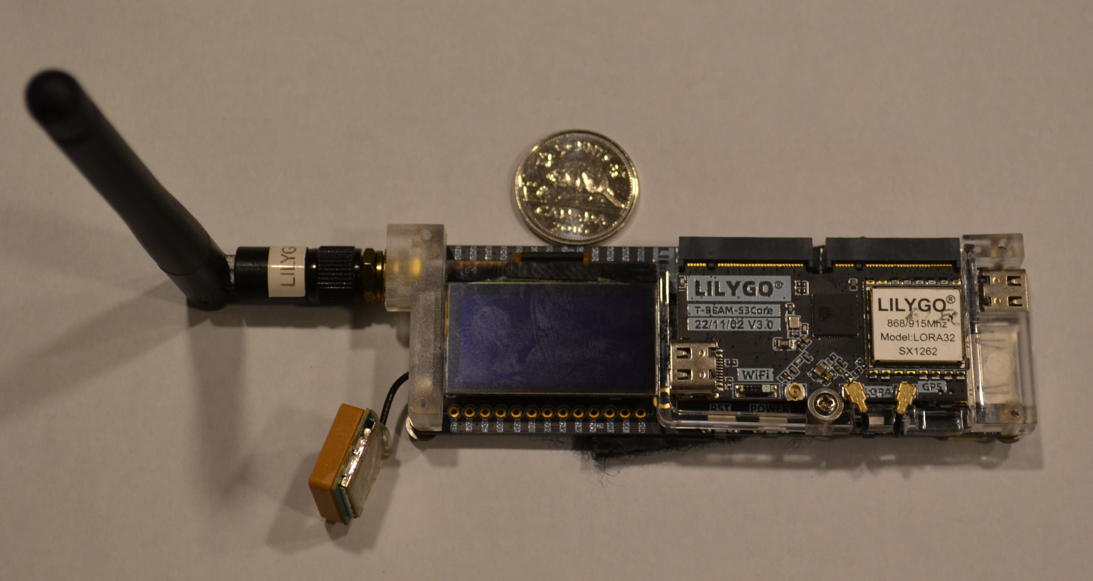
Outline
Description
Utilization in emergency communications
Integration with other systems
Critique

Slide 3
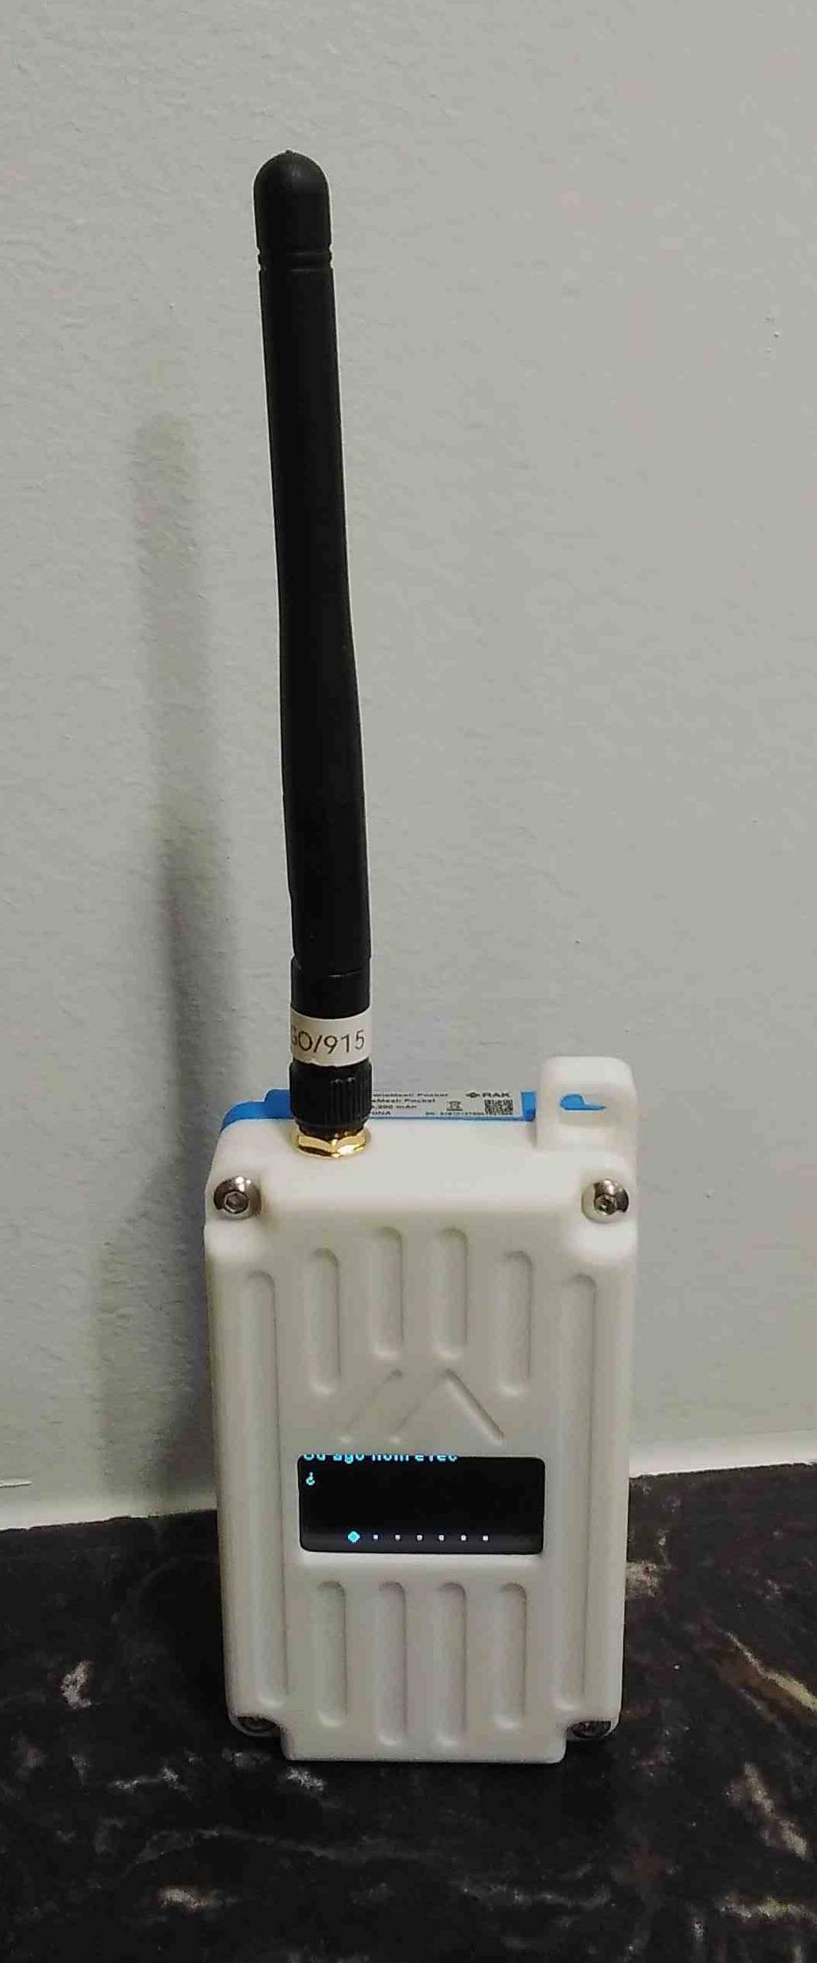
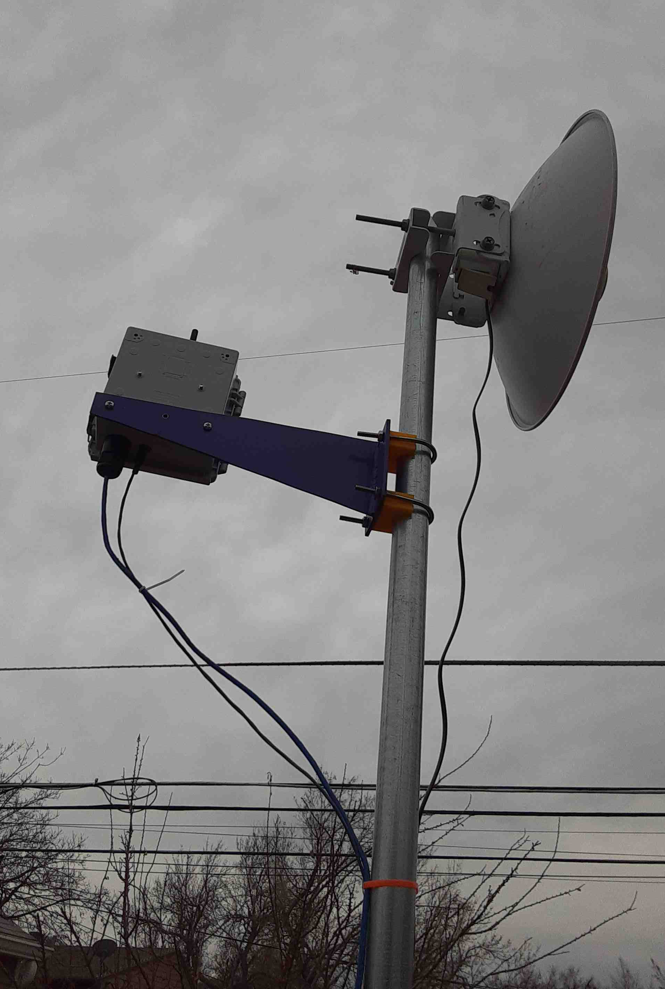
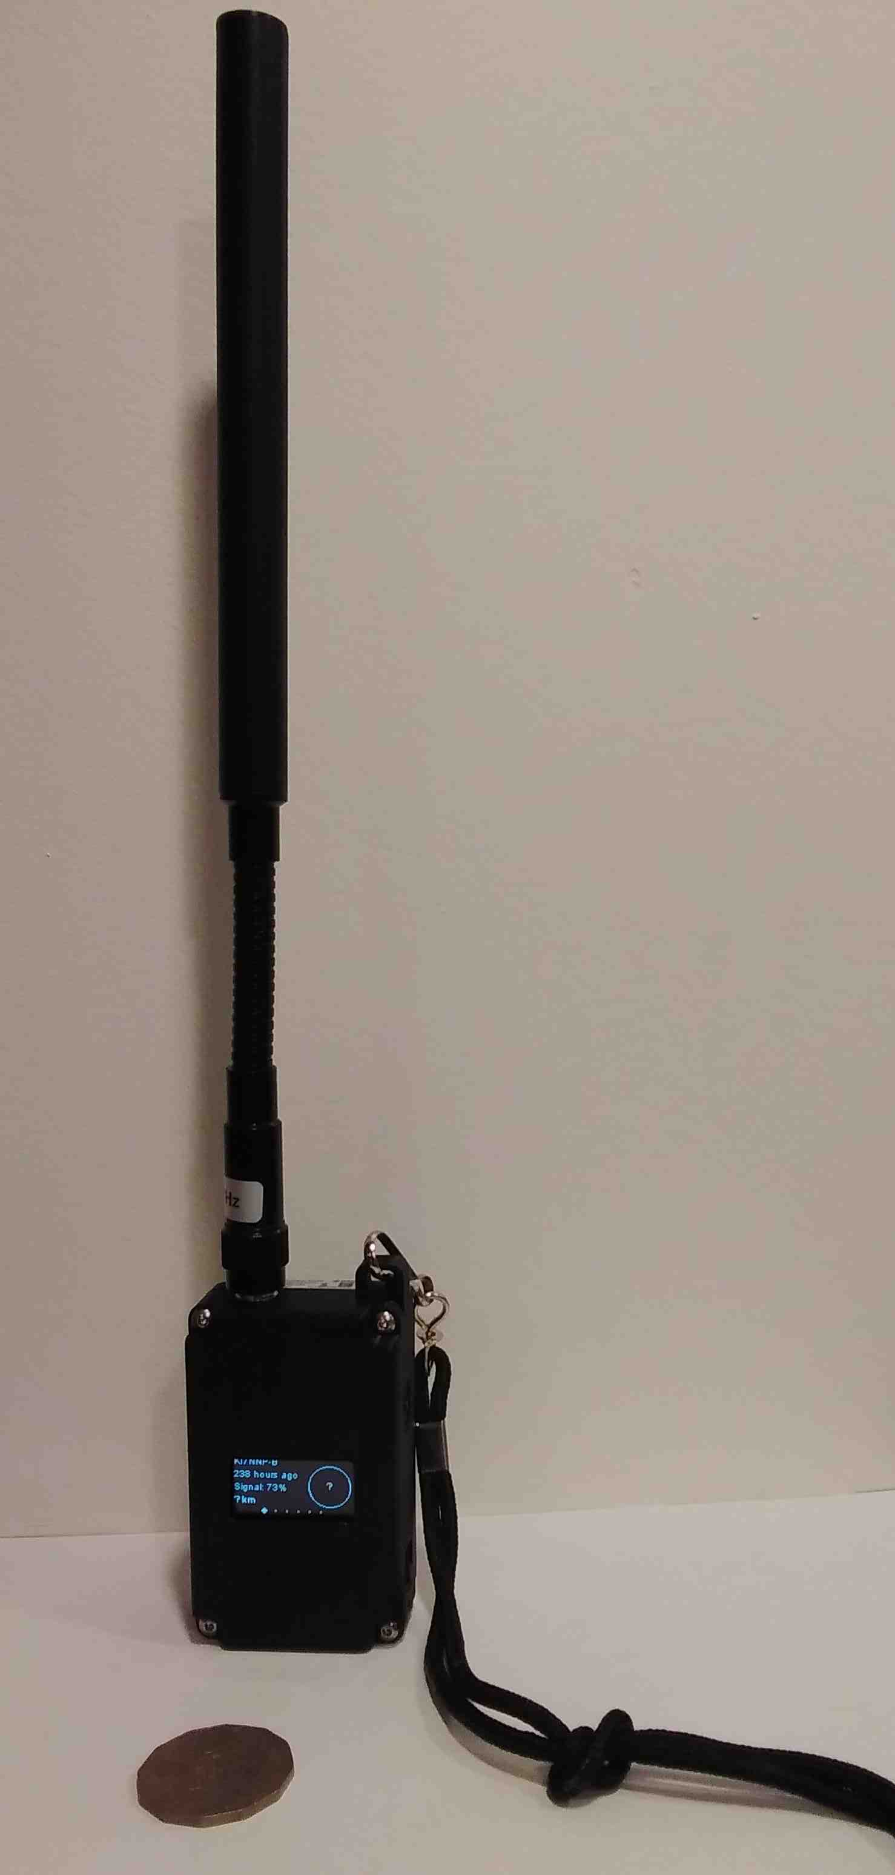
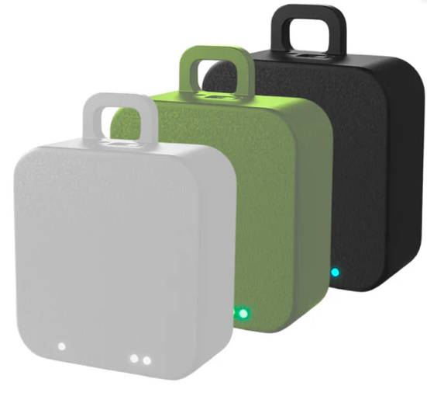
Some more

Slide 4
Description
Communication of short text and telemetry
Flood based network message passing
  Intermediate hops to get to destination
  Internet intermediary possible for world coverage
Small, low-power, low-cost hardware
  LoRa radio 915 Mhtz
  Options: GPS, Orientation, small LCDs, Wifi, sensors
  Bluetooth, WiFi, serial, push buttons, keyboard
  Phone, Tablet, Browser, Command Line Warrior interfaces
Uses
  Bitcoin mining
  Emergency communications
  Telemetry
  Super QRP

Slide 5
Emergency Communications
Pro
Medium/short range
Mesh forwarding
Connections to other networks
Small form factor
Minimal power requirement
WiFi, Bluetooth, Ethernet, Serial, keyboard interfaces
Multiple manufacturers
Phone App’s
Short messages
Open Source (sort of)
Con
915 MHz (amateur future?)
Near LOS requirement
Amateur software and design
  Mishmash of “standards”
  Inefficient use of band width
  Buggy
Low-cost, low-reliability hardware
Chinese made – subject to new tariffs and restrictions
Bitcoin miners – huge environmental impact, bad rap
Phone App
Short messages
Not plug and play – very touchy about global setup values
GPS/WiFi/OLED crank up power requirements

Slide 6
Functionality
Frequency Slots: FCC channel number #59 for amateur use
Modulation: Long Fast, Long Slow, Short Fast, ...
Channels: up to 8 are software constructs
  Channel #0 is primary channel
    Telemetry
    Position reports
    Message Passing
    Serial port
    Default name LongFast
  Channels #1 - #7 must have unique names or be disabled
  All channels share the same frequency slot and modulation parameters
A message sent on a frequency slot is received by everyone
  Software matches against channel names (subscription code)
  No channel match, no message, but node recognized if modulation matches otherwise QRM

Slide 7
Your call-sign
Long name is your call sign with -X to specify which one so you can enable amateur mode
  KI7NNP-A, KI7NNP-B …
Short name defaults to last 4 hex characters of the hardware MAC address
The names aren’t sent very often so you should set position reports for every 10 minutes which will send your call-sign
  Radio Config, Position, Broadcast Interval, 600 seconds
  Radio Config, Device, Node Info Broadcast Interval, 600 seconds
  Doesn’t work – 3600 appears to be minimum
  These are not the defaults

Slide 8
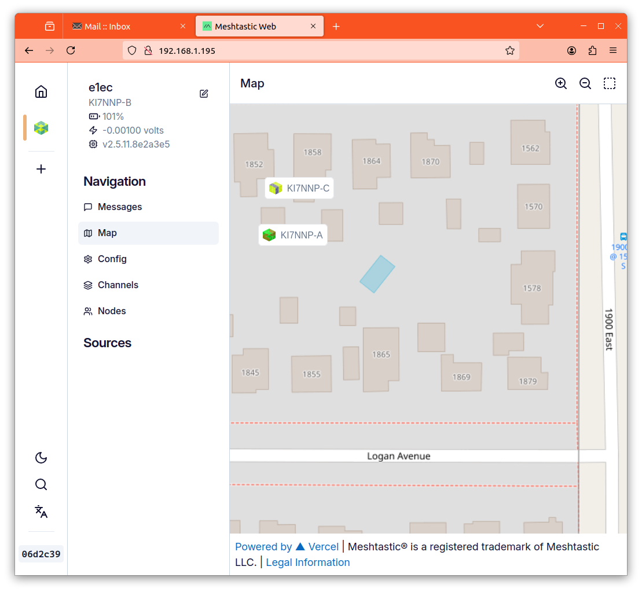
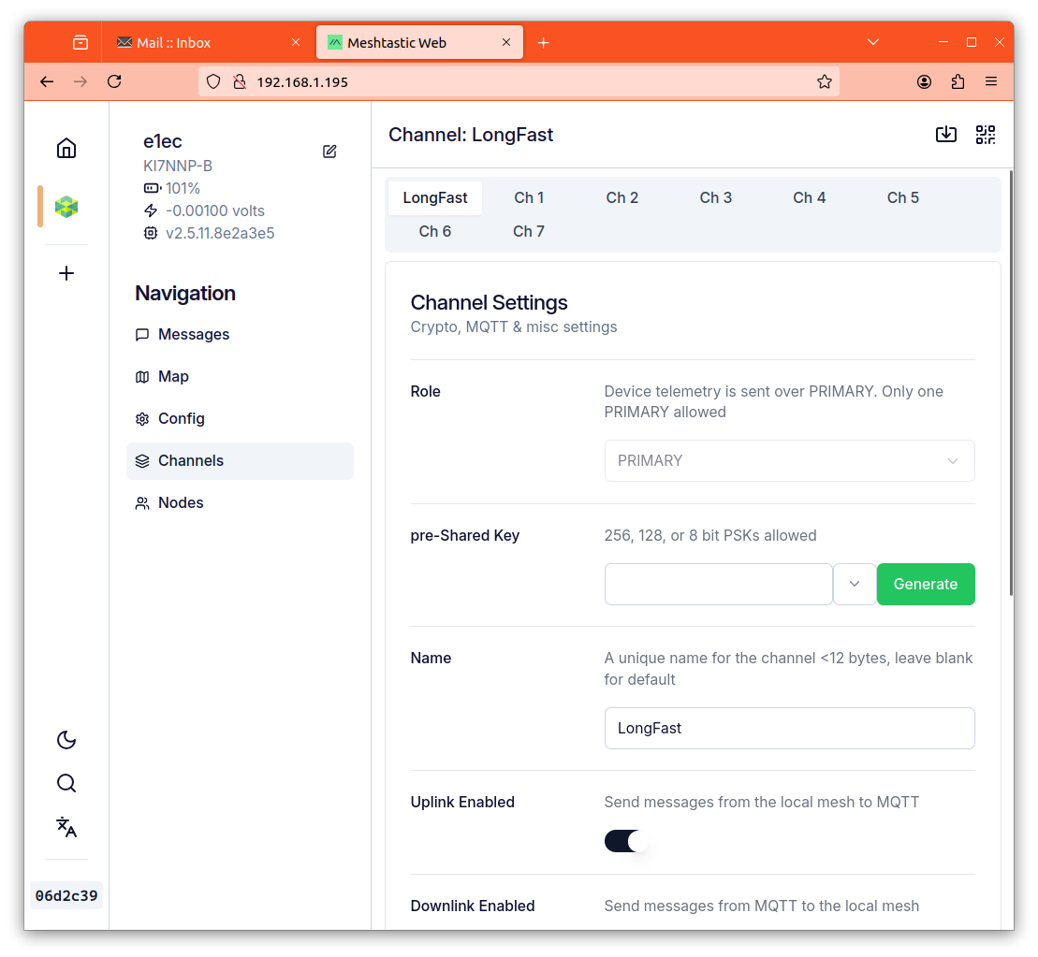
Meshtastic
Web Interface
Requires WiFi or ethernet
Browser
  Chrome for Bluetooth or Serial
  Others with WiFi or ethernet
Does not support all options
  Can’t fix location
Any OS with browser support

Slide 9
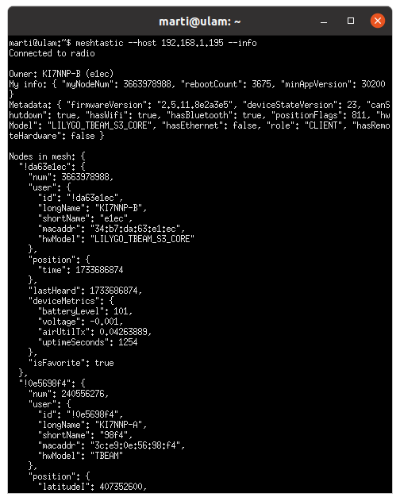
Meshtastic
Command Line Interface
Requires Python
Supports serial, Bluetooth and TCP/IP
Most general
Much output in JSON
Nordic devices may not support JSON

Slide 10
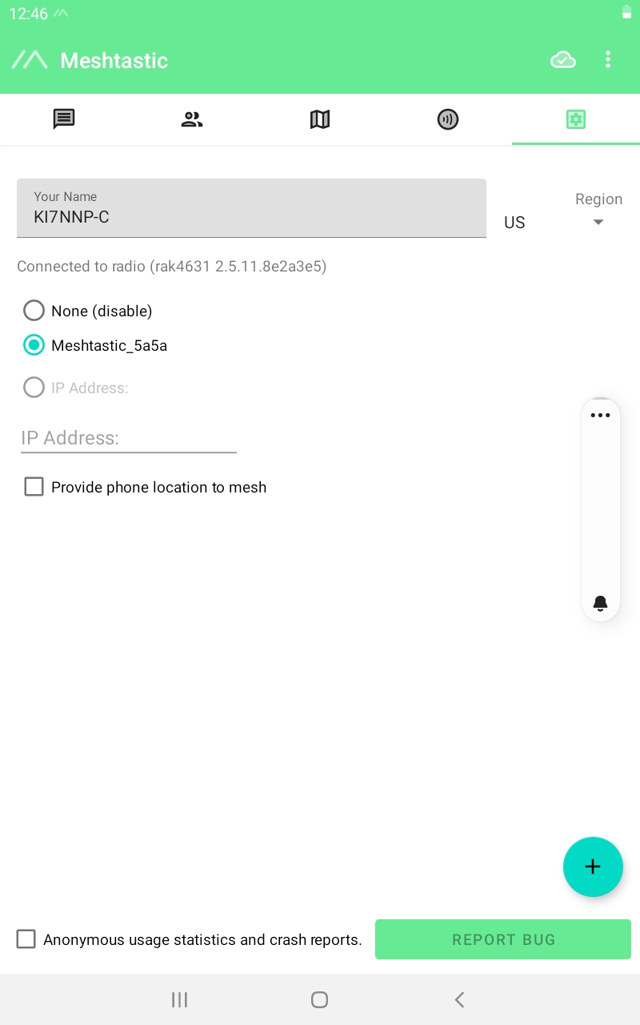
Meshtastic
Android Interface
Tablet, phone, etc.
A bit clumsy for fat fingers
Works in the field even when cell service is down
Can control multiple devices

Slide 11
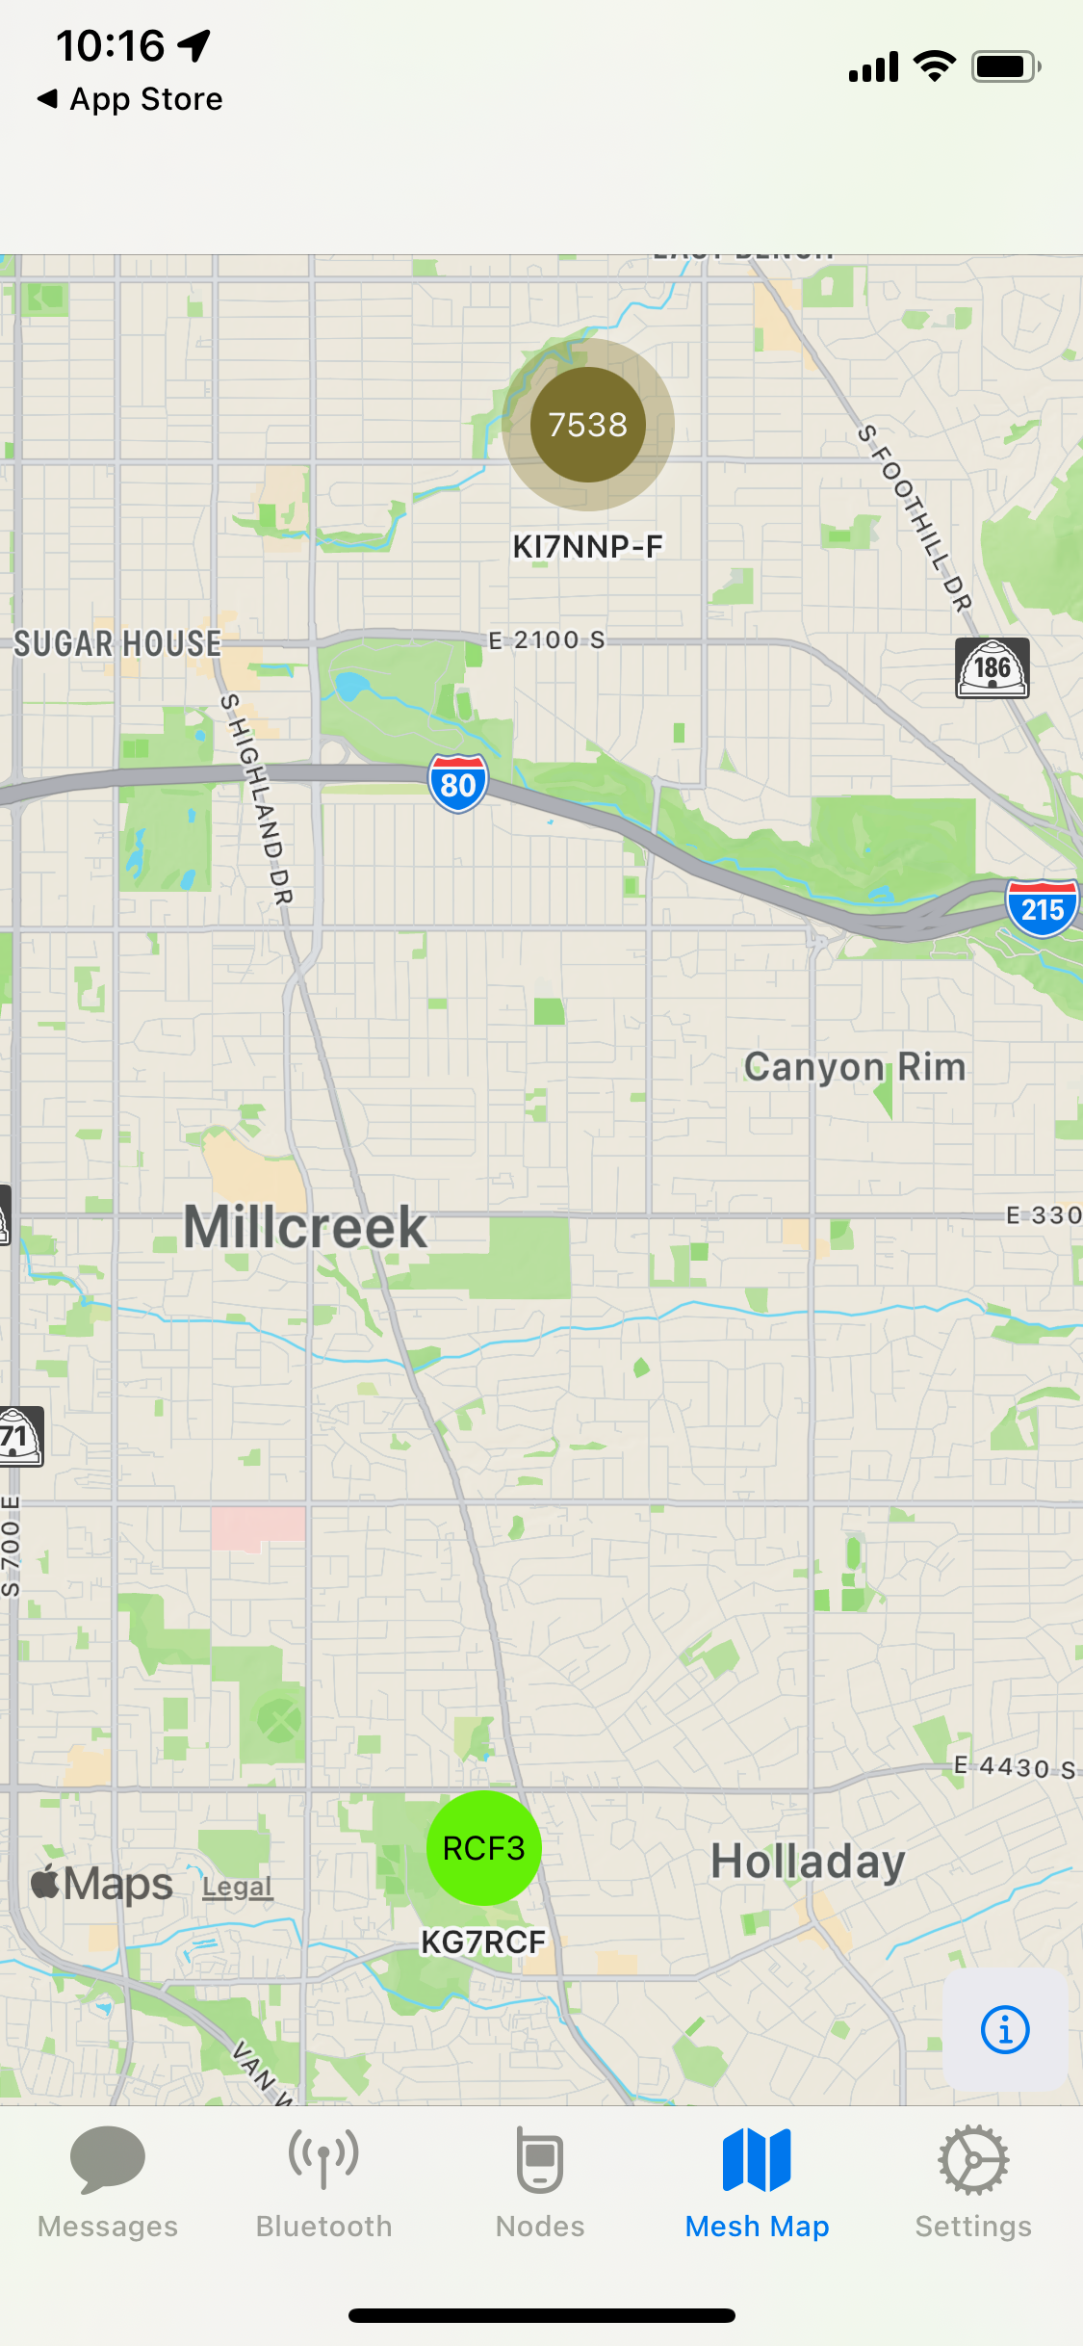
Meshtastic
iPhone Interface
Nice screen
Different feel than Android

Slide 12
Names
Places
Devices are identified with the last 4 bytes of their MAC address with a !
  e.g. !7f7e7538
A text message has only this identifier
A single contact may have only this identifier so you won’t know who sent it.
A text message does not have position information
  Only a Position, PositionLite or MapReport message contains position data
The short name defaults to the last 4 characters of the MAC address
  You can set your own
  Is not included in a text message packet
  To show on the map
Long names (and short names) are only transmitted occasionally with the NodeInfo or MapReport messages
Depending upon settings you might not get the long and short names for over an hour

Slide 13
Getting the message out
External connections through WiFi and ethernet
MQTT (Message Queuing Telemetry Transport) protocol connects device to a server
  Internet of Things community (IOT)
  Simple protocol but documents like the word “normative”
Meshtastic data a mix of MQTT and protoBufs (Google)
PC server required with internet or AREDN access

Slide 14
MQTT
Used by IOT community to connect multiple sensors, actuators, and other random things
Two versions: 3.1.1 (used by Meshtastic) 5.0 newer version
Upload data from Meshtastic to somewhere
Download data from somewhere to Meshtastic
Wraps around ProtoBufs...

Slide 15
ProtoBufs
“Language” takes record descriptions and generates code to read and write
“Efficient” use of storage for large data sets
  Except for images
  No record identity
Created and used by Google for storage of large data sets
Moderately well documented

Slide 16
Emergency communications
Less fussy than 5 GHz AREDN
Can be used by non-hams but high gain (> 6DBm) antennas make them illegal
Low cost, better range than FRS
Twitter like messages limit rag chewing
Can be connected to the internet, AREDN
  Through your phone with WiFi hotspot
  Special MQTT interfaces
QR code sharing for non hams will help with setup (maybe)

Slide 17
Meshtastic
Critique #1
Interfaces
  Web, Android, CLI – all have different capabilities.
  Wifi, Bluetooth, Serial, Ethernet
    Varying degrees of support
    Each has their own quirks
  “Self documenting code” hah!

Slide 18
Meshtastic
Critique #2
Software
GIT (Microsoft)
MQTT 3.1.1 (previous version of MQTT 5.0)
Protobufs (Google) https://protobuf.dev/programming-guides/encoding/
Arduino
PlatformIO
Commercial systems (Mosquito, etc.)
Meshtastic cloud
Hardware
  Not all devices support important components
  Integration with devices poorly documented and/or hard to find.
  Rockland a mishmash of hardware systems that don’t fit together all that well
  Hardware not robust.

Slide 19
Meshtastic
Critique #3
Protobufs is not particularly efficient.
  Efficient storage of integers base 128
  Floating-point and some integers not at all
  String storage wasteful but simple
MQTT inefficient in opposite direction.
  Just a communications protocol
  Contents are context dependent, not self describing
The resulting conglomeration overly complex for a simple system

Slide 20
Meshtastic
Critique #3
Hardware has start up problems
  Slow rise (solar) causes problems with clock starts
  Power bounce can occasionally cause configuration faults
    During power down, clock and program counter run wild for a short period and may hit flash code destroying system
Lack of ethernet causes a noisy RF environment
  RAK 4631 requires 19007 base, this works but no web server interface. This uses the NRF 52 dual core but no space left according to implementers

Slide 21
Meshtastic
Critique #4 Software
Long names aren’t sticky for some reason
Serial port issues (hardware/software)
Range test .csv files can’t be erased without reflashing the system

Slide 22
What can go wrong?
#1 Settings. The default ham settings are incomplete. Too many global settings that interact with each other.
#2 Antennas. How many couplings in the way?
#3 Line-of-Sight. 900 MHz better than 5 GHz but…
#4 Low Power settings
  Things get shut off and won’t come back on
  Long reporting times
#5 Fixed positions need CLI/Android for setting
#6 Range
#7 Network congestion - not a Ham problem yet
#8 DX mindset

Slide 23
Emergency Communications
Why Bother?
Text supplement for FRS/GMRS voice
Automatic forwarding to internet/AREDN
Users of slot #59 do not need a license except for antennas with a gain of more than 6 DBi
Familiar interface for cell phone users
Minimal training but more difficult than FRS/GMRS
Low cost
Minimal infrastructure requirements

